Slide 1


Milestone 2 – Fake Job Detection
Model Training, Evaluation & Comparison

Slide 2
Overview of Milestone 2: A Comprehensive Approach
This milestone focused on developing and refining models for fake job detection, culminating in a robust selection process.
01
02
Train Logistic Regression
Train Random Forest
Implementing a foundational classification model.
Leveraging ensemble learning for improved accuracy.
03
04
Train BiLSTM Model
Evaluate Models
Exploring deep learning for sequence data analysis.
Assessing performance against key metrics.
05
06
Cross Validation
Compare & Select Best Model
Ensuring model generalization and stability.
Identifying the optimal solution for deployment.

Slide 3


Logistic Regression: A Baseline for Classification
Our initial model utilized Logistic Regression, a powerful yet interpretable algorithm, demonstrating strong performance.
TF-IDF Features: Transformed textual data into numerical vectors using Term Frequency-Inverse Document Frequency, capturing the importance of words in job descriptions.
Hyperparameter Tuning: Optimized parameters such as regularization strength to prevent overfitting and enhance generalization.
High Accuracy & F1-score: Achieved impressive scores, indicating a balanced performance between precision and recall in detecting fake jobs.

Slide 4


Random Forest: Ensemble Power for Prediction
Leveraging the collective intelligence of multiple decision trees, the Random Forest model provided deeper insights and robust predictions.
Tuned n_estimators & max_depth: Fine-tuned the number of trees and their maximum depth to optimize performance and prevent overfitting.
Extracted Feature Importance: Identified key features that significantly contribute to distinguishing fake job postings, offering valuable interpretability.
Evaluated All Metrics: Conducted a thorough evaluation across a spectrum of metrics, including precision, recall, and AUC, to ensure comprehensive performance assessment.

Slide 5

BiLSTM Model: Delving into Deep Learning
For sequential data inherent in text, a Bidirectional Long Short-Term Memory (BiLSTM) network was employed, capturing
complex contextual dependencies.
Embedding Layer
Transformed words into dense vector representations, capturing semantic relationships.
BiLSTM Layers
Processed sequences in both forward and backward directions, enhancing understanding of context.
Dense Layers
Applied fully connected layers for final classification based on learned features.
Early Stopping
Implemented a callback to stop training when validation loss ceased to improve, preventing overfitting and saving
computational resources.
Training Curves Plotted
Visualized loss and accuracy over epochs to monitor model convergence and identify potential issues.

Slide 6



Model Comparison: Identifying the Champion
A critical phase involved a direct comparison between the traditional machine learning and deep learning models to determine the
most effective solution.
Compared Classical & Deep-Learning Models: Evaluated Logistic Regression, Random Forest, and BiLSTM side-by-side, considering their strengths and weaknesses in the context of fake job detection.
Best Model Selected Based on F1-score: The F1-score, which balances precision and recall, served as the primary metric for selecting the optimal model, ensuring robust performance in identifying both true positives and true negatives.
The model with the highest F1-score demonstrated the best overall performance in our specific detection task.

Slide 7

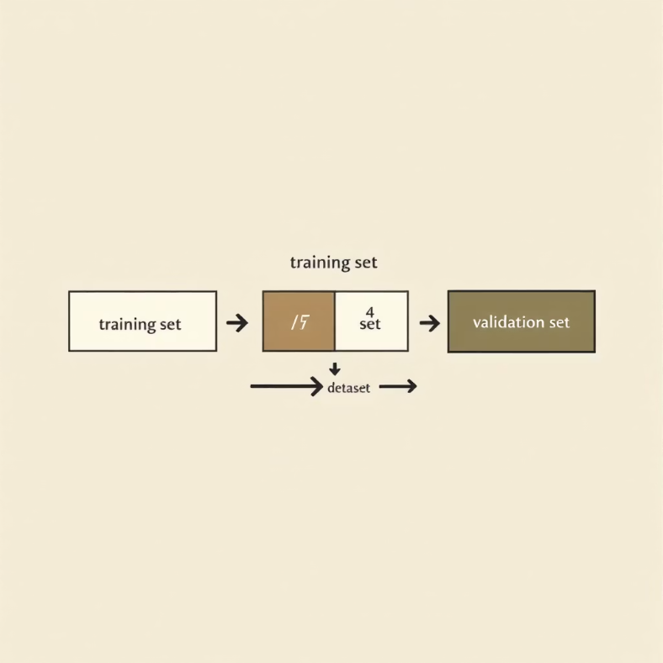
Cross-Validation: Ensuring Robustness
To validate the stability and generalization of our chosen model, 5-Fold Stratified Cross-Validation was performed, particularly on the Logistic Regression model.
5-Fold Stratified CV on Logistic Regression: The dataset was divided into five stratified folds, maintaining the original class distribution in each fold, and the model was trained and validated five times.
Performance Stability Checked: This rigorous validation process confirmed that the model's performance was consistent across different subsets of the data, indicating strong generalization capabilities and reliability in real-world scenarios.

Slide 8




Conclusion: Milestone 2 Achievements
Milestone 2 successfully laid the groundwork for effective fake job detection, bringing us closer to a robust solution.
Models Trained
Models Compared
Logistic Regression, Random Forest, and BiLSTM models were successfully developed and prepared for evaluation.
A thorough comparison identified the most effective model based on comprehensive performance metrics.
Best Model Selected
The top-performing model, demonstrating superior F1-score and
generalization, was chosen.
Ready for Milestone 3: Deployment & Refinement

